Slide 1




BIP program
Smart University, Smart Campus III edition
UNIVERSITY OF APPLIED SCIENCES “LAVOSLAV RUŽIČKA” IN VUKOVAR
SMART UNIVERSITY SMART CAMPUS III
Vukovar, Croatia

Slide 2
BIP: Smart University, Smart Campus III
Organizer / Host HEI: University of Applied Sciences “Lavoslav Ružička” in Vukovar
Venue: Vukovar, Croatia (Blage Zadre 2)
Format:
•Virtual component (pre-arrival)
•Physical mobility: 20–24 April 2026
BIP ID: 2025-1-HR01-KA131-HED-000319380-1
Credits: 3 ECTS
Working language: English

Slide 3

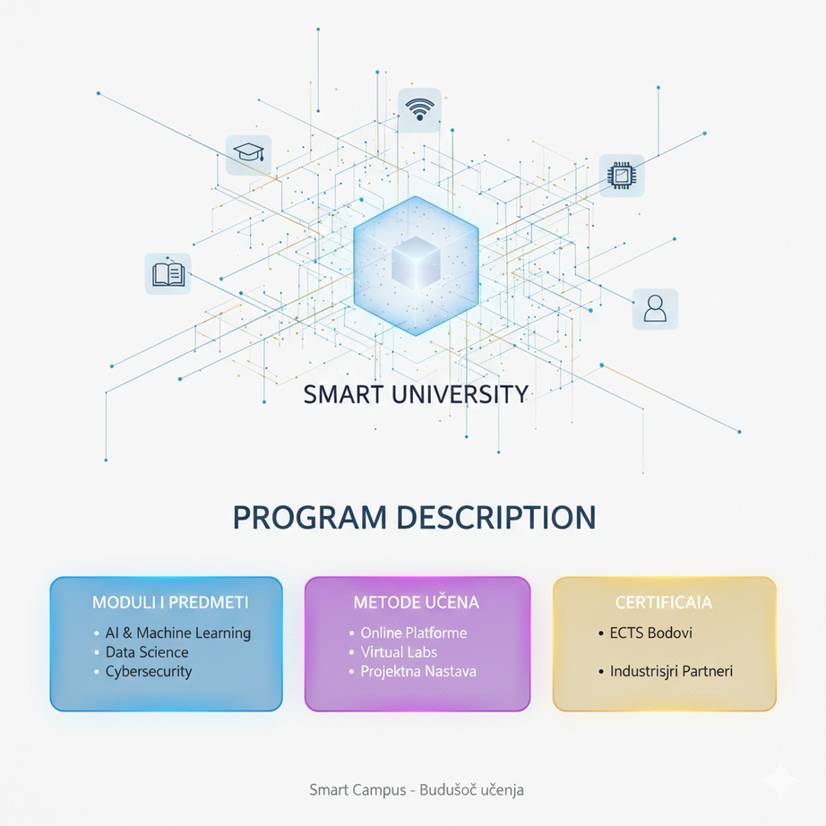
Program description
01
The “Smart University, Smart Campus III” is an interdisciplinary Blended Intensive Program combining online sessions and in-person activities. Students will work in mixed, interdisciplinary teams on practical, hands-on challenges related to smart campus development. Interdisciplinary field.
BIP mail field: Interdisciplinary field - (0188) ISCED
Participants gain skills in:
•smart university/campus design and digital solutions
•interdisciplinary teamwork
•innovation and problem-solving
•sustainability and wellbeing in higher education
Target group: 20–30 undergraduate and graduate students from: Economics (0410) Law (0488) Physiotherapy (0915)
Objective: To foster interdisciplinary collaboration and innovation within smart learning and campus environments.
(In line with the program priority: Digital transformation)

Slide 4

Thematic Framework:
02
Lecturers and experts are invited to propose interactive lectures, workshops, or group tasks focused on the following themes:
Smart and Sustainable Campus
(digital solutions, resource management, economic sustainability, legal frameworks)
• Health, Wellbeing, and Ergonomics in the Smart Campus
(physical activity, injury prevention, space design, digital health support)
• Digital Transformation of Higher Education
(data management, personal data protection, ethical and legal issues)
• Innovation and Interdisciplinary Solutions
(team-based idea development involving economics, law, and physiotherapy students)
• Case Studies and Project-Based Learning
(work on real smart campus challenges and final project presentations)
Activities should be designed for groups of 20–30 students and aim to encourage interdisciplinary collaboration and practical application of knowledge.

Slide 5

03
Staff participation
Lecturers and experts may participate as:
BIP Lectures/teachers - facilitators
•Online-only contributors
•In-person contributors
•Blended contributors (online + in-person)
The methodology is at the discretion of the lecturer or expert, in line with the previously selected mode of participation (online, in-person, or blended).
Final involvement depends on expressed participant interests/
Sending /Home HEI Nomination according the available Erasmus+ funding Sending HEI (KA171 – STA mobility). Consult your HEI Erasmus coordinator or relevant person in IRO office.
Participation of staff is welcome but not mandatory for sending student participants and revers.

Slide 6
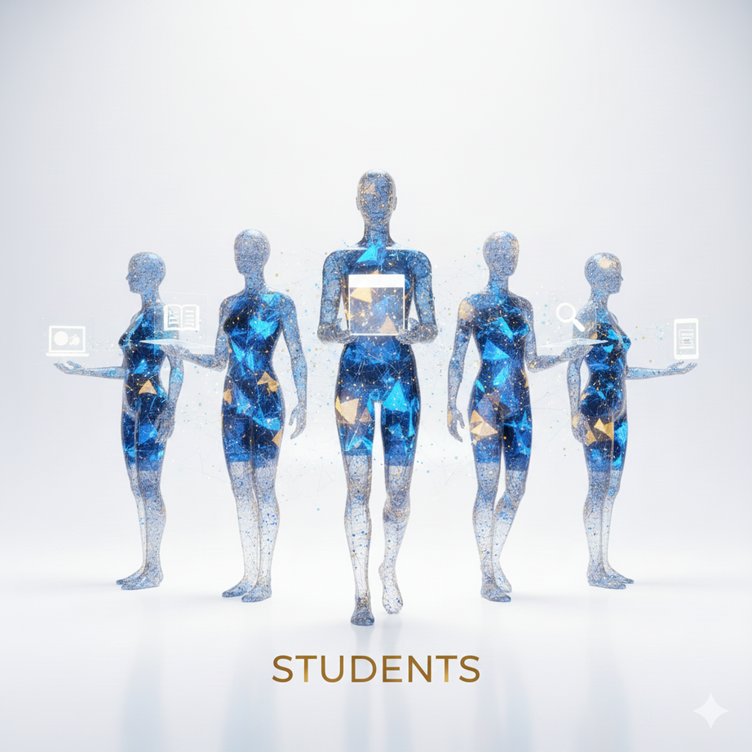
05
Student participation
04
SMS/BIP participants
Nominated by sending/home HEI - Outgoing students from partner HEIs may participate:
• with Erasmus+ grants or as zero‑grant participants
• Mobility format: 5 days of physical mobility + mandatory online component
• Recommended number per institution: 3 students
3 ECTS recognized (as part of the curriculum or as extra-curricular ECTS, recorded in the Diploma Supplement).
.

Slide 7

05
Learning Outcomes
Agenda
Participants will be able to:
• understand key elements of the Smart University and Smart Campus concept
• apply basic principles of digital transformation and data protection
• analyse sustainability and wellbeing in campus environments from an interdisciplinary perspective
• develop and present innovative solutions through team-based project work
Detailed learning outcomes will be finalized once thematic units and lecturers are confirmed.
The detailed agenda will be developed based on the expressed interests and proposed topics of participating lecturers.
A finalized program will follow once all contributions are confirmed.

Slide 8
06
📣 23 Jan 2026
Official Invitation for Partner HEIs
9 February 2026
📝 Staff expression of interest - must be submitted via the form provided in the link.
18 March 2026 - Nomination deadline (by sending institutions) –
🎯 SMS/BIP participants link.
STA participants link.
23 – 26 Mar 2026
📄 learining Agreement/ Staff Mobility Agreement completion & participant registration
13 –16 Apr 2026
💻 Online component
20 –24 Apr 2026
✈️ Physical mobility at VEVU
After BIP
✅ Participant evaluation
Plan timeline

Slide 9

07
Host Contact
VEVU Erasmus+ Coordinator:
Karolina Novinc, Master of European Business Studies,
International Cooperation and Projects Assistant
📧 karolina.novinc@vevu.hr

Slide 10


Expression of Interest
08
Smart ideas, smart people, and a smart campus — we hope to welcome you in Vukovar!
WARM REGARDS, AND THANK YOU FOR YOUR VALUED PARTNERSHIP!

